Slide 1
MEASURES OF RELATIONS (Correlation)

Slide 2
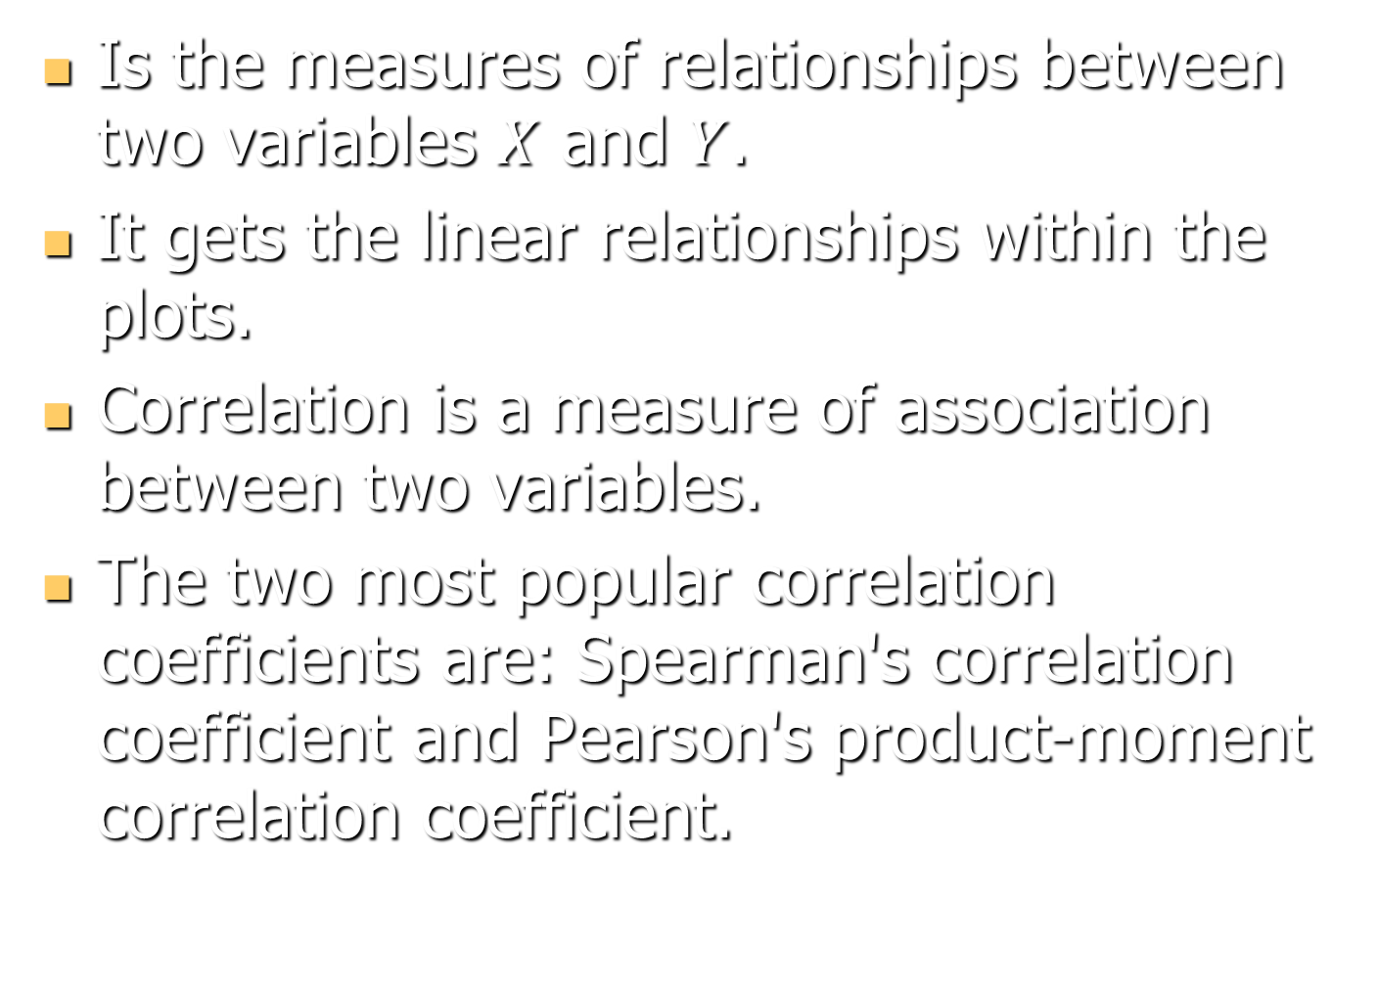
Is the measures of relationships between two variables $X$ and $Y$.
It gets the linear relationships within the plots.
Correlation is a measure of association between two variables.
The two most popular correlation coefficients are: Spearman's correlation coefficient and Pearson's product-moment correlation coefficient.

Slide 3
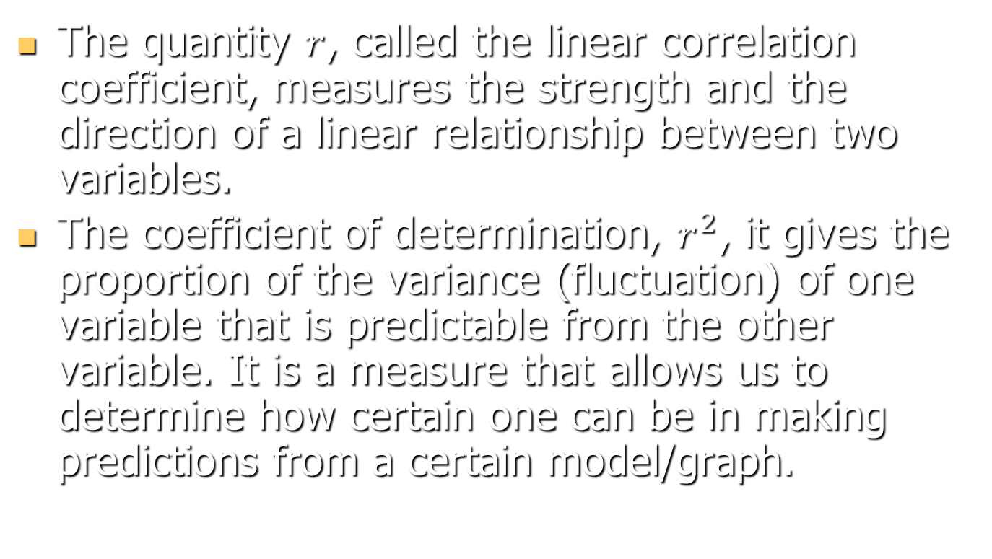
Correlation Coefficient And Coefficient of Determination
The quantity $r$, called the linear correlation coefficient, measures the strength and the direction of a linear relationship between two variables.
The coefficient of determination, $r^{2}$, it gives the proportion of the variance (fluctuation) of one variable that is predictable from the other variable. It is a measure that allows us to determine how certain one can be in making predictions from a certain model/graph.

Slide 4
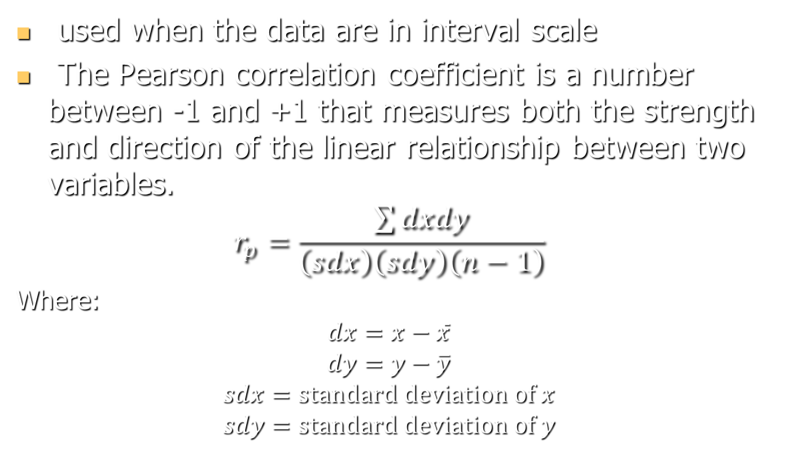
Pearson's product moment correlation coefficient
used when the data are in interval scale
The Pearson correlation coefficient is a number between -1 and +1 that measures both the strength and direction of the linear relationship between two variables.
$$r_{p}=\frac{\sum{dxdy}}{\left(sdx\right)\left(sdy\right)\left(n−1\right)}$$
Where:
$$dx=x−\overline{x}$$
$$dy=y−\overline{y}$$
$$sdx=standard deviation of x$$
$$sdy=standard deviation of y$$

Slide 5
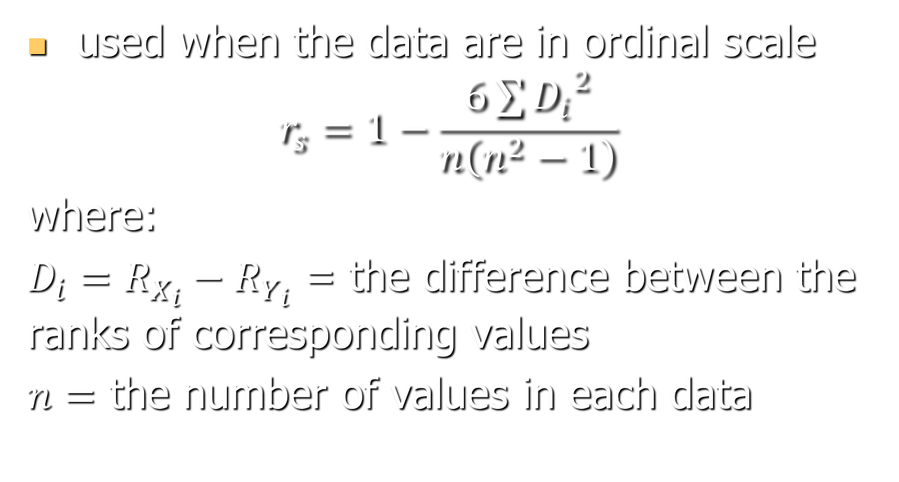
Spearman's rank correlation coefficient
used when the data are in ordinal scale
$$r_{s}=1−\frac{6\sum{{D_{i}}^{2}}}{n\left(n^{2}−1\right)}$$
where:
$D_{i}=R_{X_{i}}−R_{Y_{i}}$ = the difference between the ranks of corresponding values
$n=$ the number of values in each data

Slide 6


IQ, X_{i} | Hours of TV per week, Y_{i} | rank x_{i} | rank y_{i} | d_{i}
86 | 0 | 1 | 1 | 0 | 0
97 | 20 | 2 | 6 | −4 | 16
99 | 28 | 3 | 8 | −5 | 25
100 | 27 | 4 | 7 | −3 | 9
101 | 50 | 5 | 10 | −5 | 25
103 | 29 | 6 | 9 | −3 | 9
106 | 7 | 7 | 3 | 4 | 16
110 | 17 | 8 | 5 | 3 | 9
112 | 6 | 9 | 2 | 7 | 49
113 | 12 | 10 | 4 | 6 | 36

Slide 7
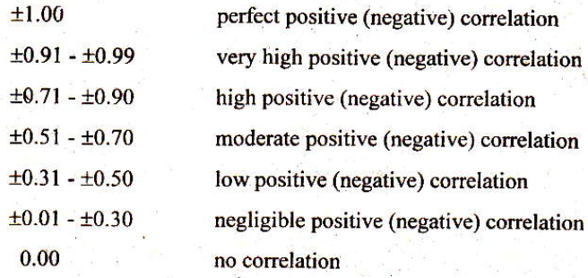
Guide in interpreting the
coefficient of correlation

Slide 8
The value of r is such that -1 < r < +1.
The sign (±) of the correlation coefficient indicates the direction of the correlation. A positive (+) correlation coefficient means that as values on one variable increase, values on the other variable tend to also increase; a negative (−) correlation coefficient means that as values on one variable increase, values on the other tend to decrease, that is, they tend to go in opposite directions.

Slide 9

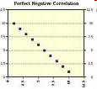
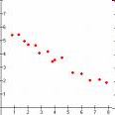
Perfect Positive Correlation
Perfect Negative Correlation
Strong Negative Correlation
Notes:
9

Slide 10
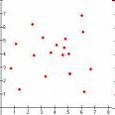
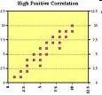
No Correlation
Strong Positive Correlation
Notes:
10

Slide 11
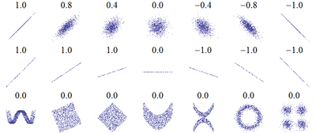
Sample..

Slide 12
Example 1. Beauty & Sociability. Person Beauty Sociability
A 3 3
B 1=most 2
C 2 1=most
D 5 4
E 4 5
N=5

Slide 13
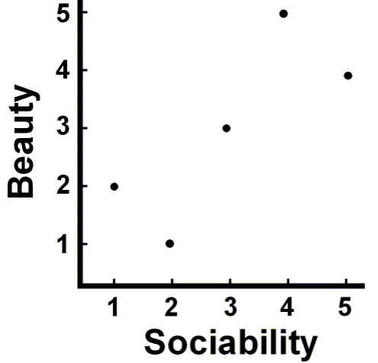

Slide 14
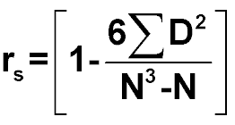
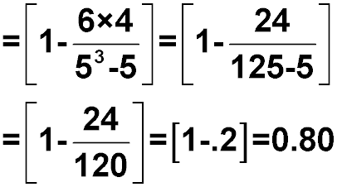
Person | Beauty | Sociability | D | D²
A | 3 | 3 | 0 | 0
B | 1=most | 2 | -1 | 1
C | 2 | 1=most | 1 | 1
D | 5 | 4 | 1 | 1
E | 4 | 5 | -1 | 1
N=5 |  |  | åD=0 | åD²=4

